Slide 1

Bachelor Of Technology
Computer Science and Engineering (Data Science)
311 Program in collaboration with Virginia Tech. USA
Mini-Project Presentation
SVKM’s NMIMS
Mukesh Patel School of Technology Management and Engineering, JVPD, Vile Parle, West
Mumbai- 400056

Slide 2

A PRESENTATION ON
“Future Predictions For COVID-19”
By
Soham Vasudeo & Ritika Shetty
L039 & L040
Faculty Mentors:
Prof. Ami Munshi, Prof. Mahesh Mali and Prof. Khinal Parmar

Slide 3
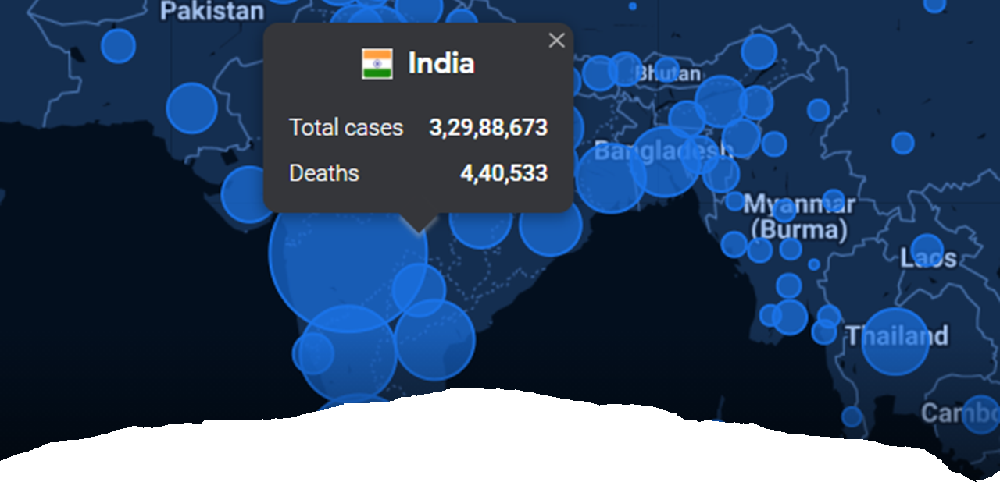
Introduction
Notes:
The world has witnessed the COVID-19 (corona virus disease 2019) pandemic that has affected many lives across the globe. The spread of this virus has exponentially risen. Therefore, on 11th March 2020, the World Health Organization (WHO) announced COVID-19 as a “Global Pandemic” ​
​
Due to the outbreak of COVID-19, an unavoidable situation stirred up, whereby authorities of various continents and countries had to put restrictions on the movement of people and non-essential activities. Some of these restrictions included imposing lockdowns, maintaining social distancing, work from home in academics, and business continuity plans.​
​
In our mini project we are trying to implement models for the COVID-19 data that we were povided with and tryting to write a suitable Python code for analysis and Data Visualisation of the data provided.

Slide 4
Literature Survey
Sr No. | Description
1. | Estimation of COVID-19 prevalence in Italy, Spain, and France In this paper, the ARIMA (auto-regressive integrated moving average) model has been used to predict the future trends on COVID-19 in the 3 worst affected countries of Europe- ie Italy, Spain and France. The author has thoroughly analyzed different models and parameters and decided that ARIMA would best predict the epidemiological trend of COVID-19.
2. | COVID-19: Short term prediction model using daily incidence data In this paper, prediction of the dynamics of the new SARS-CoV-2 infections has been evaluated and a short-term forecasting has been done using the Poisson distribution model for the daily incidence number, and a Gamma distribution for the series interval. This method helped to predict the no of COVID cases in a single state in US and the method gave accurate results when they were compared to the current data
3. | Projections for novel coronavirus (COVID-19) and evaluation of epidemic response strategies for India The author of this paper has used the modified SEIR method to predict the COVID-19 curve in India where they carried out 10,000 simulations using Python Programming. Through the SIER method, they have studied the effect of social distancing on COVID-19 and produced different graphs for the same. The author has also been able to provide and predict a short-term forecast on COVID in different states and which would be the worst hit during the pandemic

Slide 5

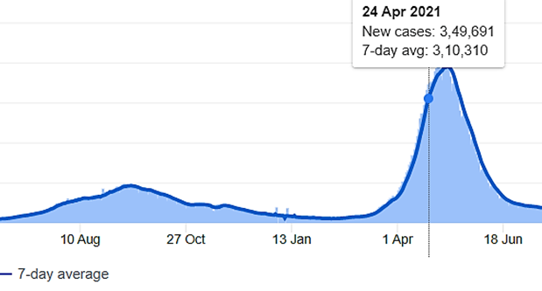

Problem Statement
Future Predictions for COVID-19.
ARIMA Model- SARIMA Model

Slide 6
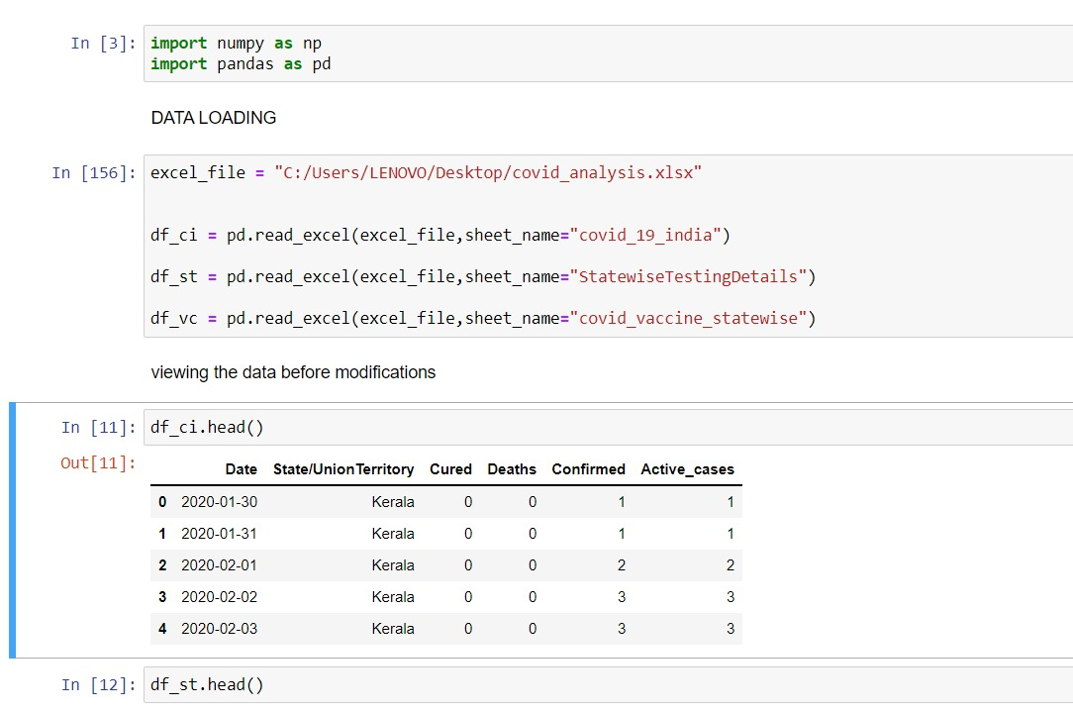
Implementation
We have made an Introductory PPT
We wrote Python code for cleaning the dataset.
In addition, we implemented a code for a Statistical model for Future Predictions of COVID-19 cases
We drew sample Dashboards on white papers till we achieved perfection.
After finalizing our design, we implemented it on 'Power BI'.

Slide 7




System Description
Libraries used in Python:
Numpy
Pandas
Folium
Matpotlib
Plotly
Software used for analyzing data
Jypter Notebook
Software used for visualizing data
Power BI

Slide 8
Flow chart
Importing numpy and pandas to work on the dataset
Loading Excel files in Python
Viewing the data before modifications

Slide 9
Flow chart
Put the excel data into data frame
Cleaning the data in the data frame
Converting the clean Data frame into excel file to use it for Visualization

Slide 10
Flow chart
Adding data visualization libraries for basic exploratory analysis in python
Adding various graphs for exploratory analysis
Starting to implement statistic model

Slide 11
Flow chart
Adding libraries for statistical model (SARIMA predictions)
Find the values for order of SARIMA model
Implement the order into the python code

Slide 12
Flow chart
Plot for the given prediction
Using scatter plot with lines and markers to visualize the prediction

Slide 13
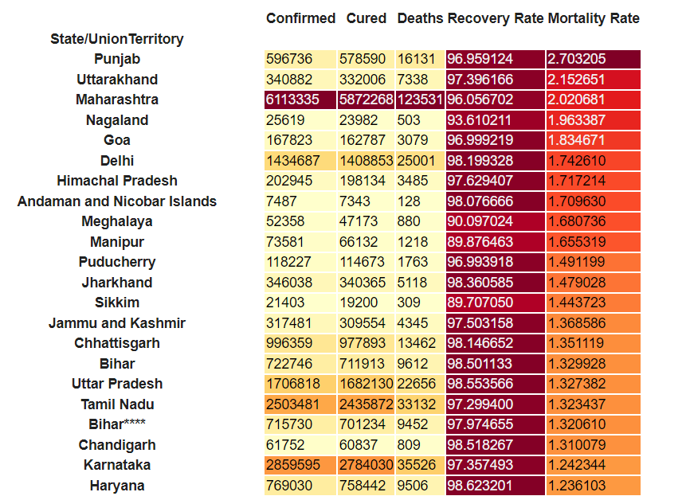
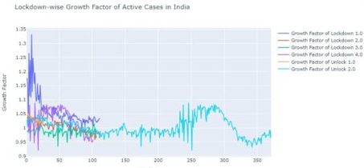
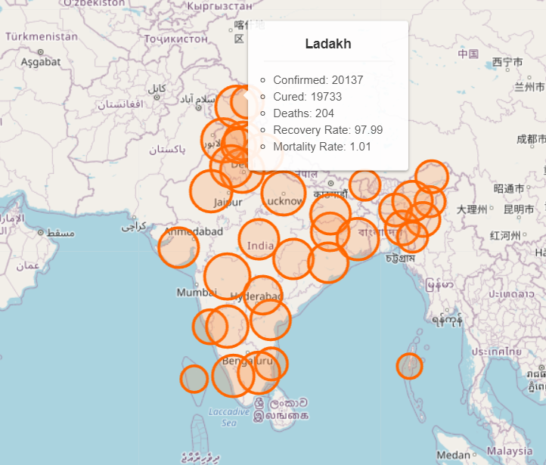
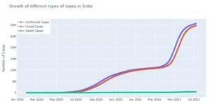
Graphs for Visualization in Python

Slide 14
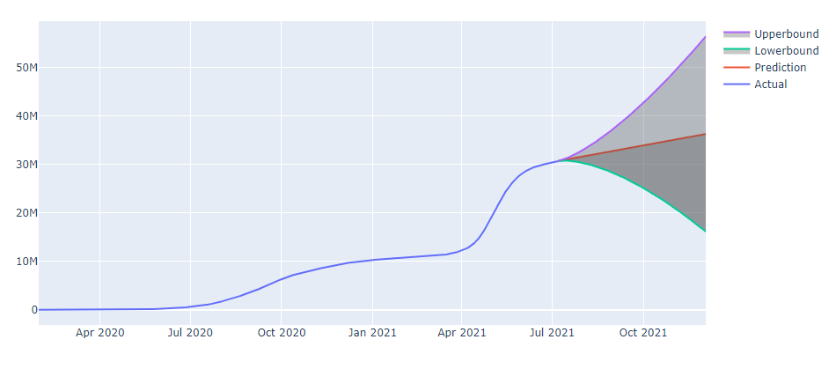

Result and Analysis
Notes:
Upon cleaning and sorting the data we did some exploratory data analysis in which we visually represented

Slide 15
Reference
https://www.sciencedirect.com/science/article/abs/pii/S0048969720323342?via%3Dihub
https://journals.plos.org/plosone/article?id=10.1371/journal.pone.0250110
https://www.sciencedirect.com/science/article/abs/pii/S0377123720300770?via%3Dihub

Slide 16
THANK YOU !!

